Slide 1


Debugging Strategies in Deep Learning
Mohamed Faiz - 210171601030
Mohamed Faraazman Bin Farooq S - 210171601031
Mohamed Fouzan Ayubi K - 210171601032
Mohamed Irfan S - 210171601033
Mohamed Mafaz - 210171601034
Mohamed Nasar L - 210171601035
Mohamed Nowfal M - 210171601036
Mohamed Sakeel A - 210171601037

Slide 2


Slide 3
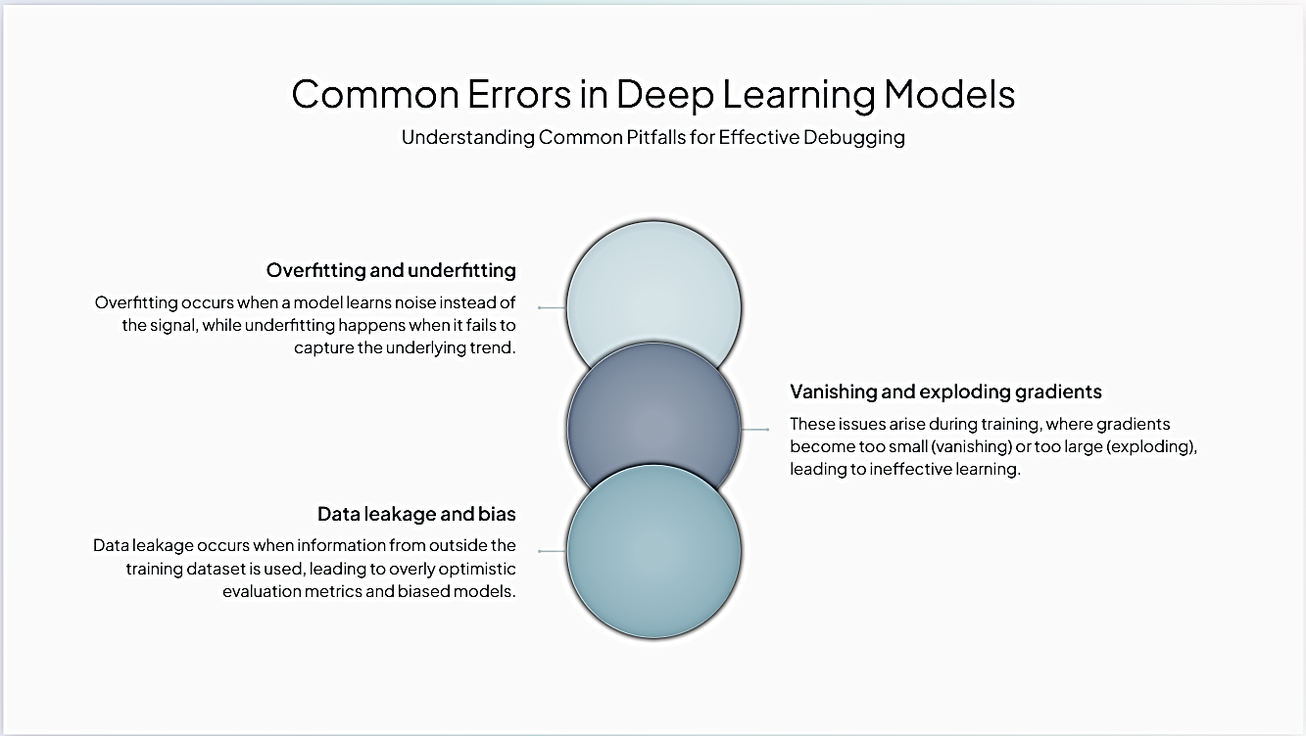

Slide 4
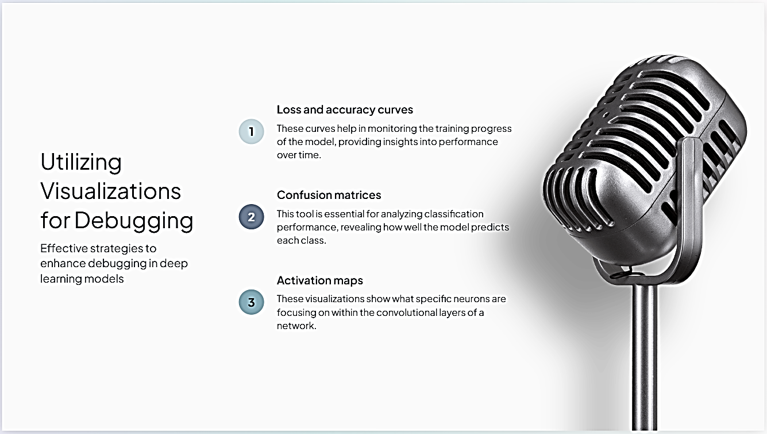

Slide 5
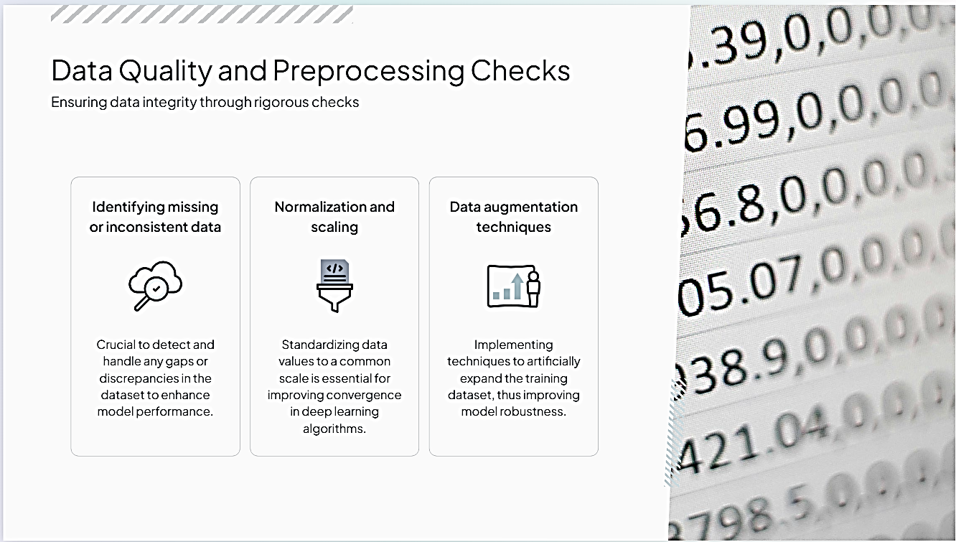

Slide 6
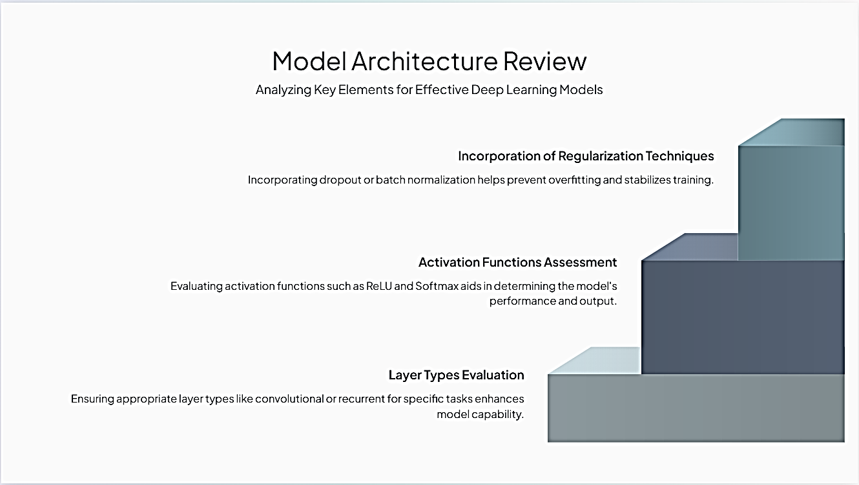

Slide 7
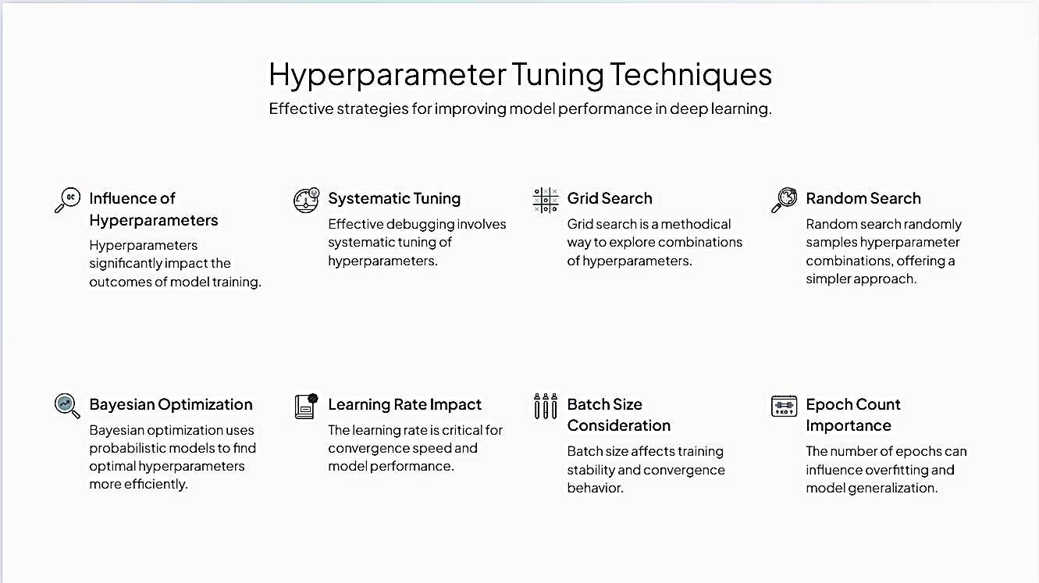

Slide 8
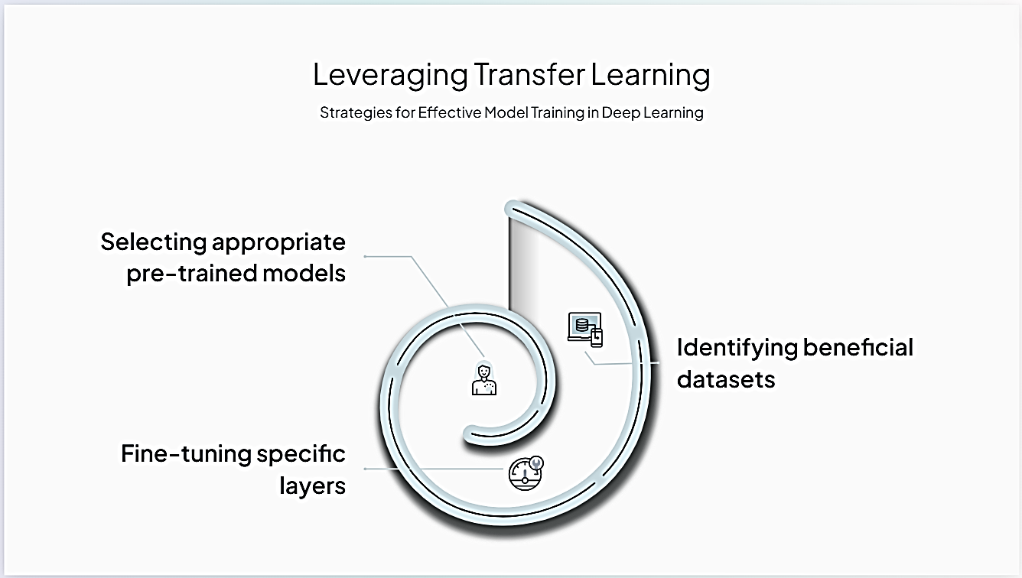

Slide 9
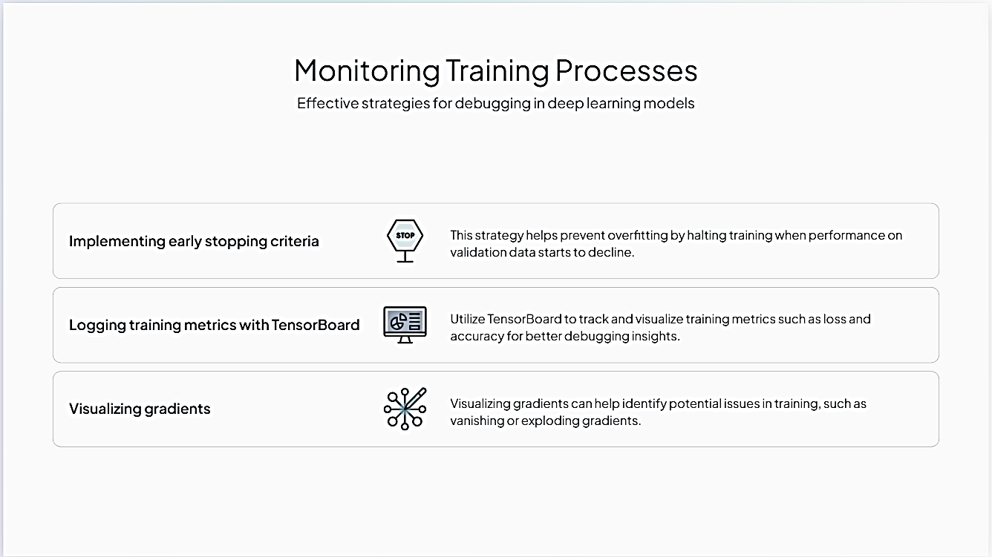

Slide 10
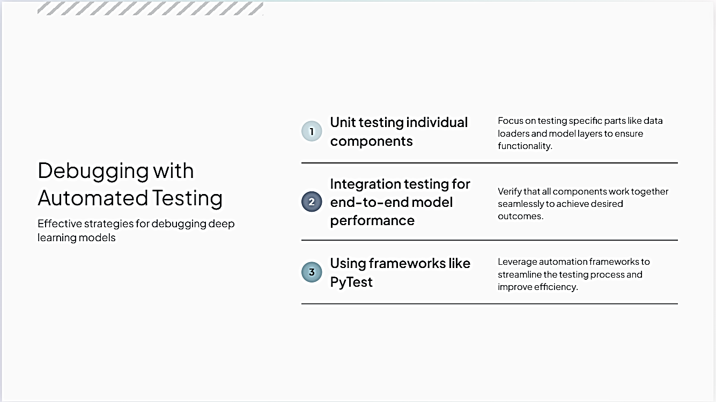

Slide 11
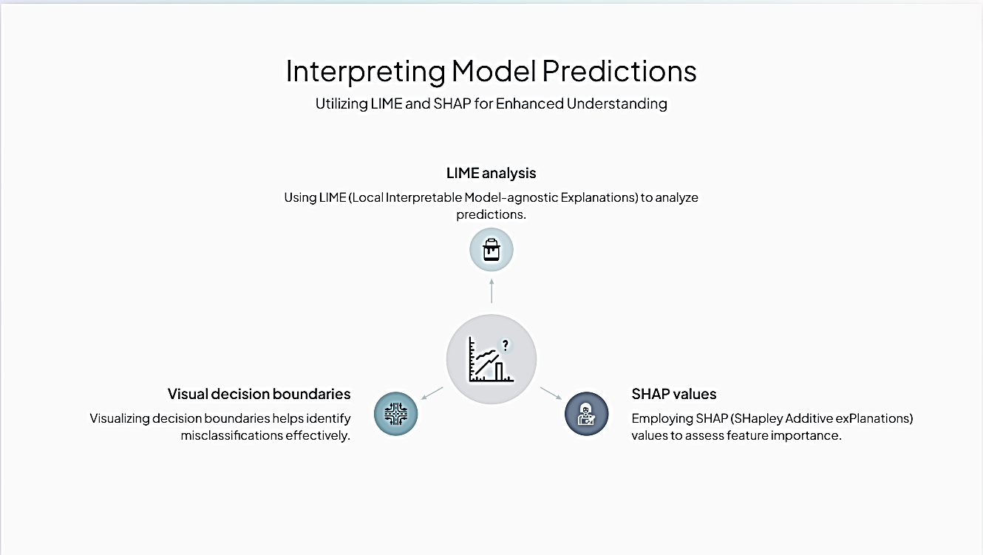

Slide 12


Slide 13
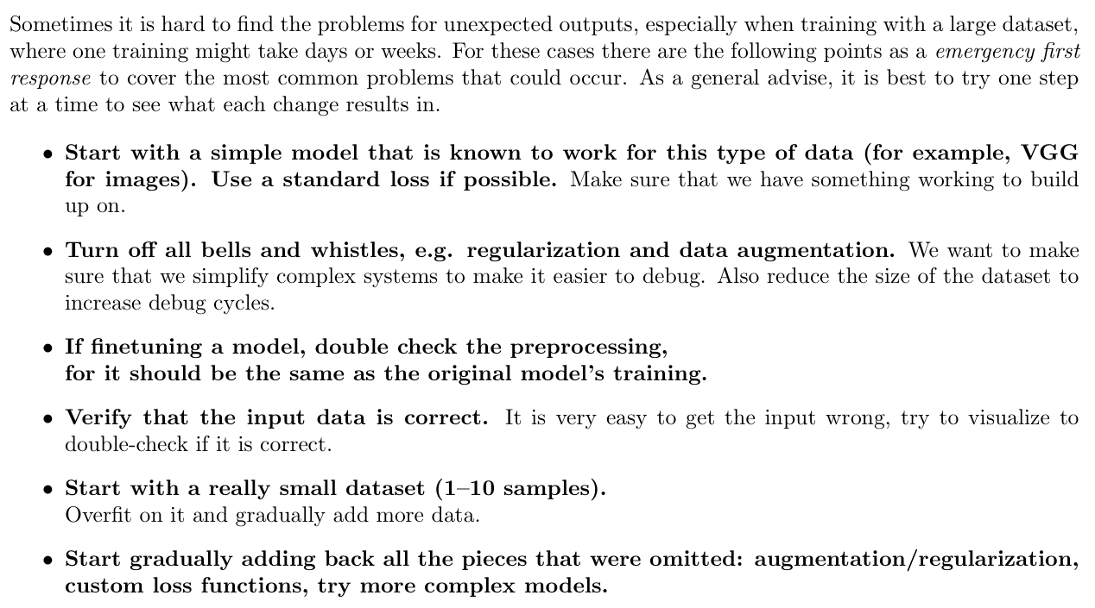
Emergency First Response

Slide 14
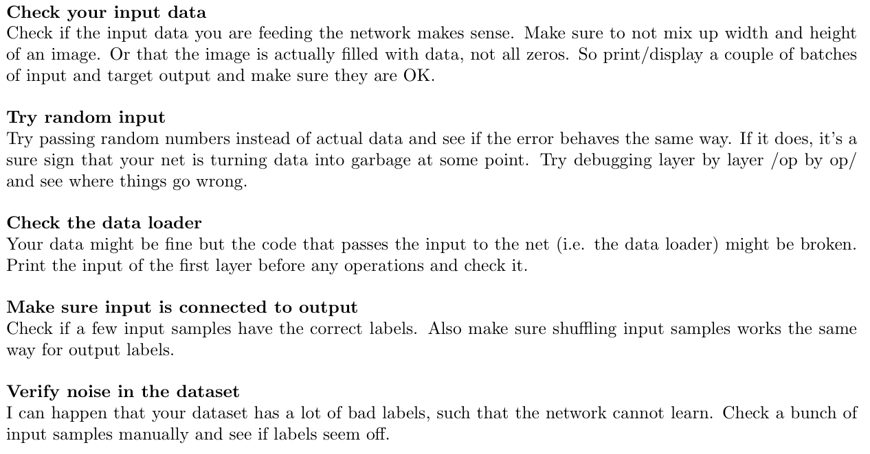
Dataset Issues

Slide 15
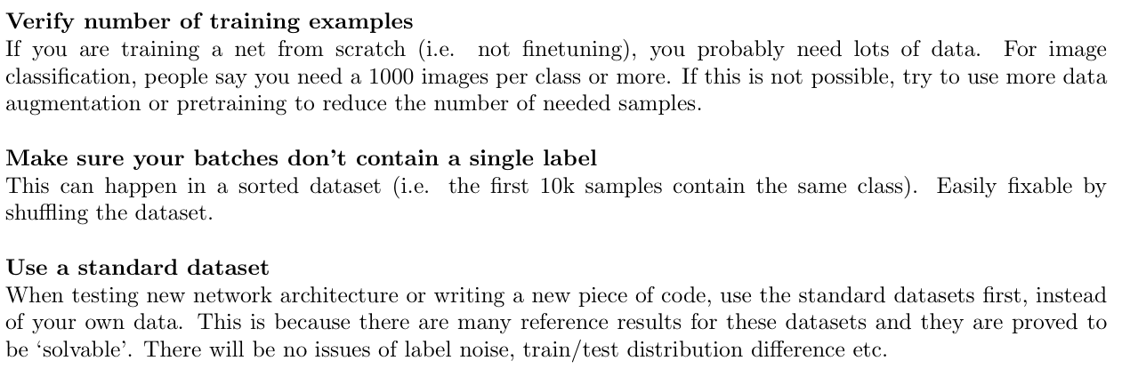
Dataset Issues

Slide 16
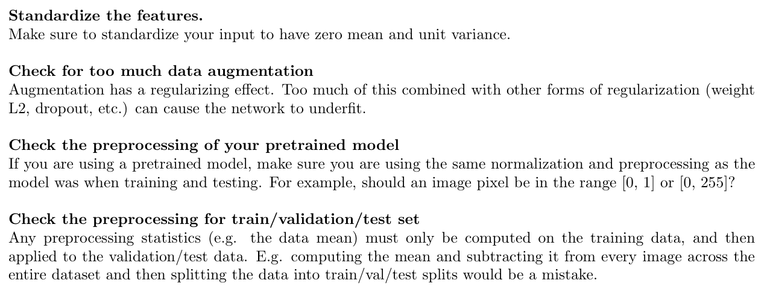
Data Normalization / Augmentation Issues

Slide 17
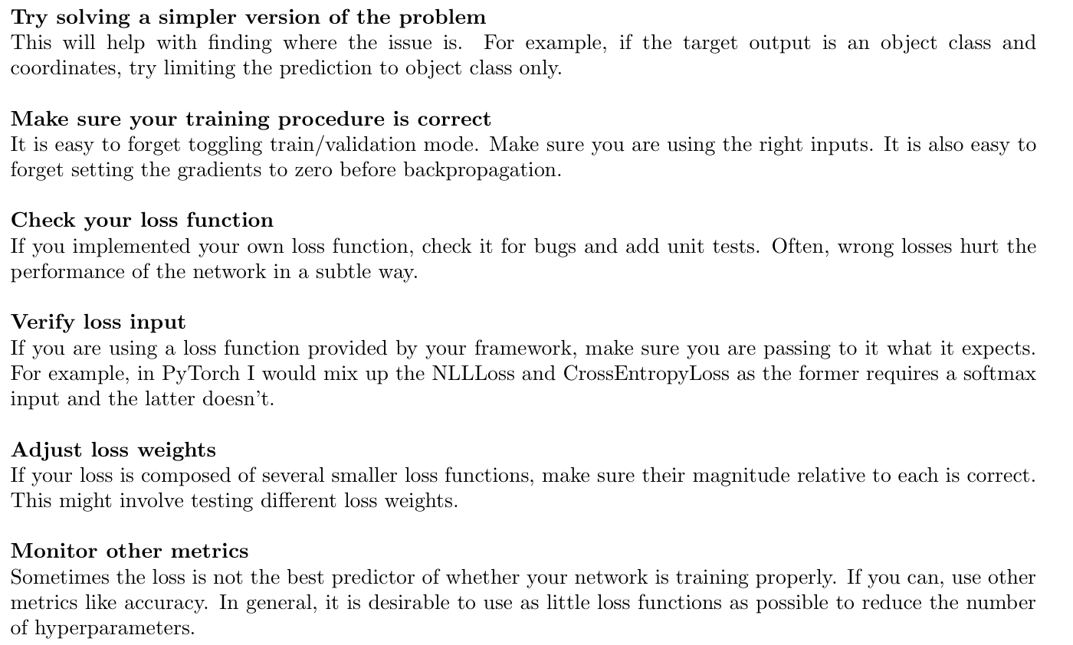
Implementation Issues

Slide 18
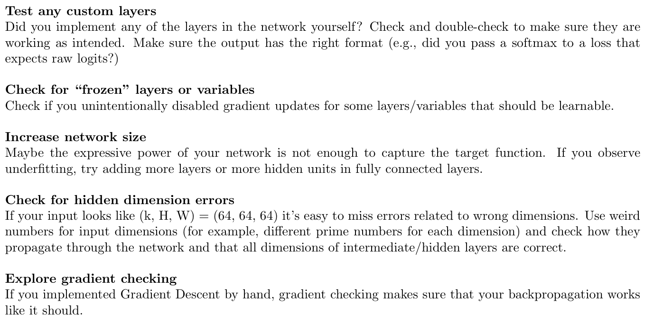
Implementation Issues

Slide 19
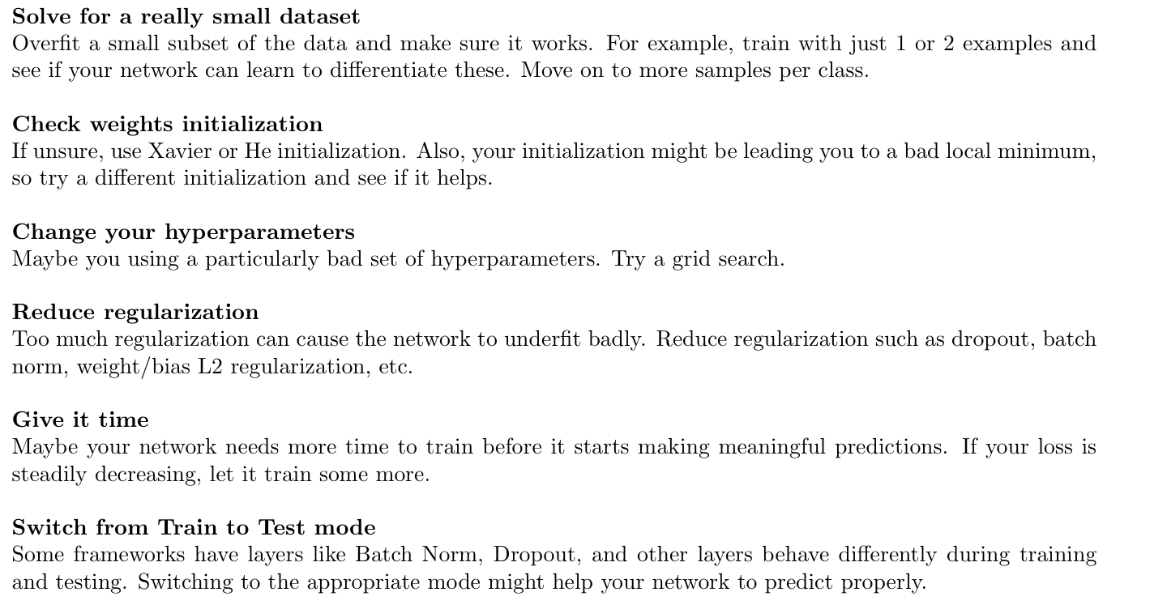
Training Issues

Slide 20
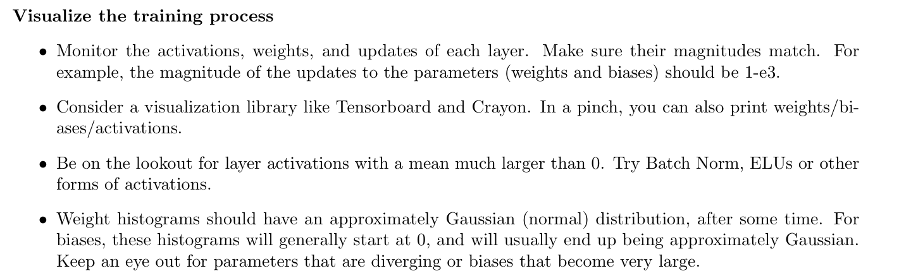
Training Issues

Slide 21
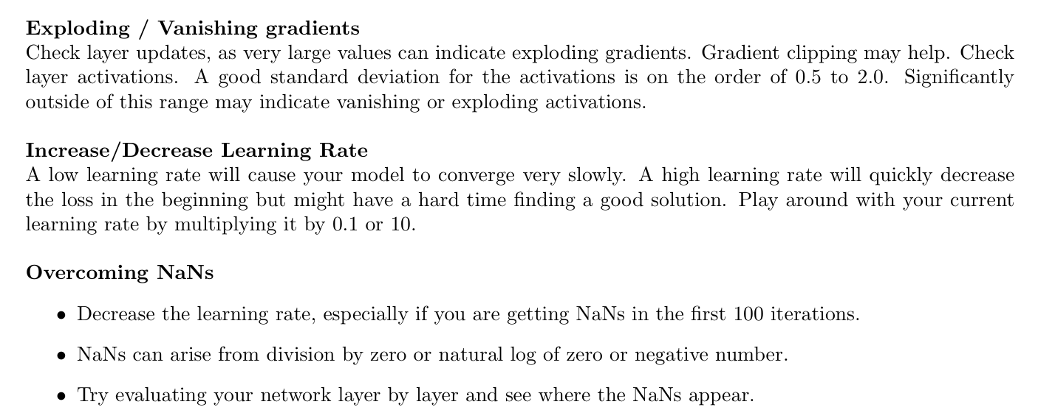
Training Issues

Slide 22


Slide 23


Slide 24


Slide 25


Slide 26
Most-used model debugging strategies
Sensitivity analysis
Sensitivity analysis is a statistical technique that estimates how sensitive a model, parameter, or other quantity is to changes in the input parameters from their nominal values. This analysis shows how a model reacts to unseen data, and what it predicts from given data. Developers often refer to it as the “What if” analysis.
Suppose we have a model that predicts housing prices will rise by 10% given a 10% rise in a specific area.
To see if this is true, we simulate data where the population increases by 10%. If predictions are correct and housing prices increase by 10%, it’s done. However, if the prediction is off, for example, the predicted value of housing doesn’t change, then the model is sensitive to changes in one or more of its input variables. With sensitivity analysis, we can figure out which input variable(s) are causing the problem. What if the prices increase by 10%, 20%, or 50%? It will help us demonstrate that prices are sensitive to changes in buyer traffic.
The example above is a prediction of an unknown quantity (housing prices). For models that make predictions about known quantities (e.g. the stock market), sensitivity analysis is even more important. The What-if-tool is the best way to visually monitor the behavior of trained ML models, with minimal coding.
Sensitivity analysis will help us study all the variables in depth. Because of this, predictions become more trustworthy. It also helps developers to recognize what could be improved in the future.

Slide 27
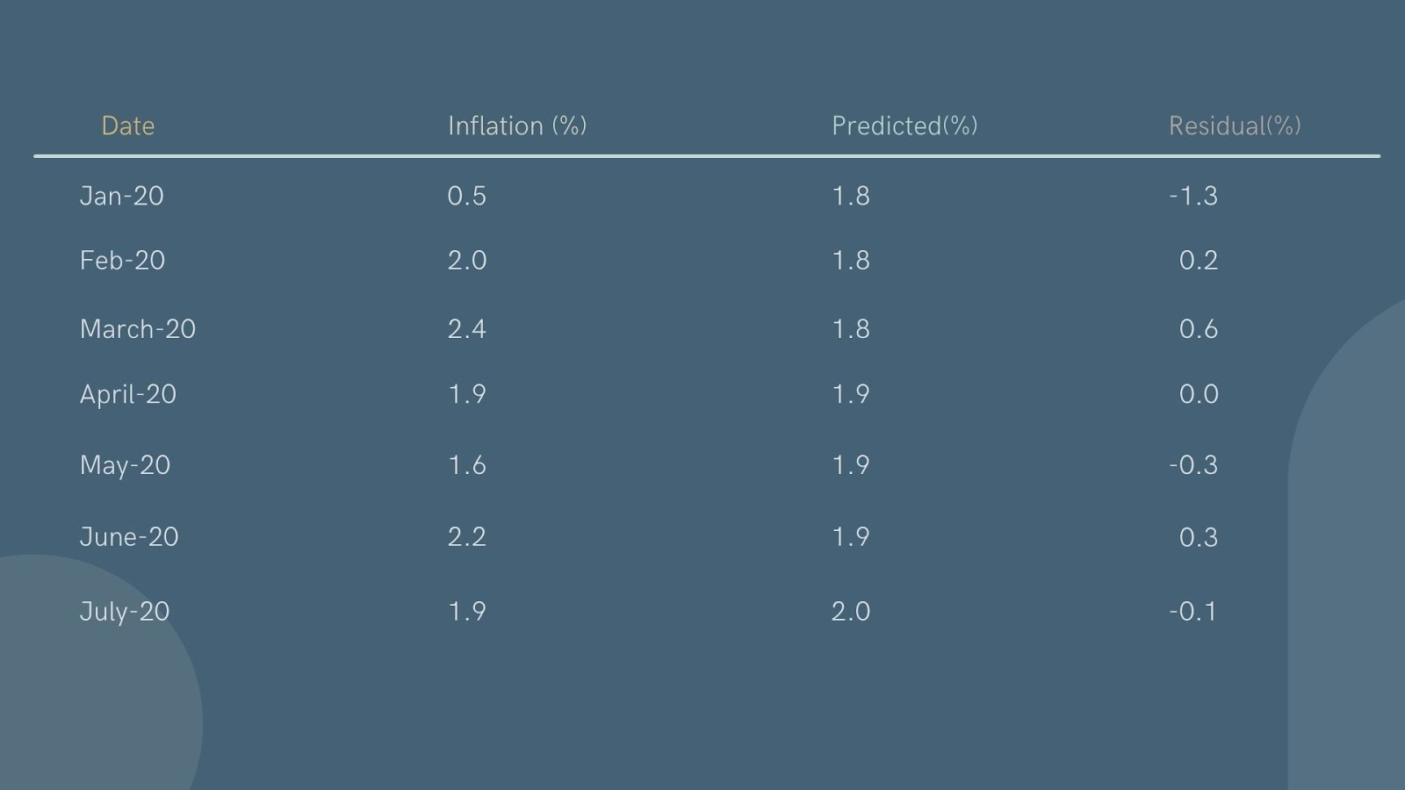
Residual analysis
The most used method among data scientists and developers. It’s a numeric evaluation of model errors and the difference between observed and predicted outcomes.
Residual plots are very helpful in determining where a model is wrong (misclassifying data points). In simple terms, residuals can be calculated by subtracting predicted values from observed values. Classified as Quantile Plots and Scatter Plots
Residuals = Observed Values (Inflation for above image) – Predicted values
So, let’s take the case of June 2020. The observed value of inflation was 2.2% and the predicted value of the model is 1.9, so the residual is 0.3. A small residual value often means the model is correct, and a large residual value often means that something is wrong with the model.

Slide 28

THANKYOU

